Slide 1
CROWE Valley conservation Hearing Guidelines for Ont. Reg 159/06
Presentation for Board Meeting
February 25, 2021
Notes:
Good day everyone,
My name is Robert Cole and I am a Regulations Officer at Crowe Valley Conservation Authority.
I would like to take this opportunity to refresh you all on the board hearing process as well as go over some of the changes to the procedure to permit electronic hearings. This presentation has been recorded so we can upload it to our Board Members Webpage as a resource to you all prior to any future board hearings.

Slide 2
Why are we Talking About hearing guidelines?
There is a potential for several a CVCA Hearings in the near future.
Notes:
Why are we talking about Hearing Board guidelines today?
Again there are two reasons for going over at this time, the first is that the procedures for hearings has changed to allow for electronic hearings due to the Pandemic. The second reason is because it may happen soon. (CLICK) CVCA Officers are currently working with several landowners that have submitted permit applications that are outside the scope of what a CVCA Regulations Officer has the Authority to approve. (CLICK)
Currently, the applicant has been informed that we cannot approved the proposed works in their current form. They have a couple of options to consider. They can amend their permit application so that it aligns with our policy requirements, or they have a right to request a Hearing (CLICK). This means they can request to come before you in order to request an exception from our policy manual.
The two images on this slide direct you to where you can learn more about our Watershed Planning and Regulations Manual, specifically our Hearing Guidelines on page 151, Appendix D. Today, I am reviewing the most important guidelines from this appendix with the hopes that you will read the entire Appendix prior to any CVCA Hearing Board Meeting.

Slide 3
Today’s objectives
Introduction to the CVCA’s Hearing process
What is the purpose of a hearing?
When is a hearing called?
Who is involved with a hearing?
What are the duties of a Hearing Board?
What is the process for the hearing?
Notes:
Today, my goal is to have each CVCA Board Member walk away with an understanding of the our Board Hearing Process. Some of you will have experience a CVCA Hearing, while others may have little to no experience at all.
By the end of today, hopefully you will be able to answer the following questions: (CLICK)
1. What is the purpose of a hearing? (CLICK)
2. When is a hearing called?(CLICK)
3. What parties are involved with a hearing?(CLICK)
4. What are your duties as the Hearing Board?(CLICK)
5. What process are you expected to follow during a hearing? (CLICK)

Slide 4
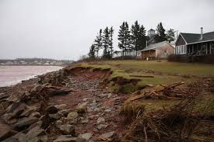
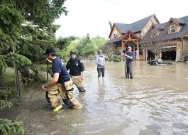
CVCA regulations Program
Delegated Authority under the Conservation Authorities Act to regulate development near environmental features and natural hazards.
Notes:
Before we get into the details of the Hearing Guidelines on the upcoming slides, I’ll first provide an overview of how it is that an applicant arrives as a CVCA Hearing Board. (CLICK)
CVCA Regulations Officers have been given authority by the CVCA Board and under the Conservation Authorities Act to regulate development near environmental hazards and features (CLICK) for the purpose of public safety, property (CLICK) and the environment. This is achieved by requiring permits for development adjacent to natural hazards and environmental features.
Natural hazards can be floodplains associated with a watercourse, steep slopes, soil erosion or unstable bedrock. Natural features that we regulate could be rivers, lakes and wetlands.

Slide 5
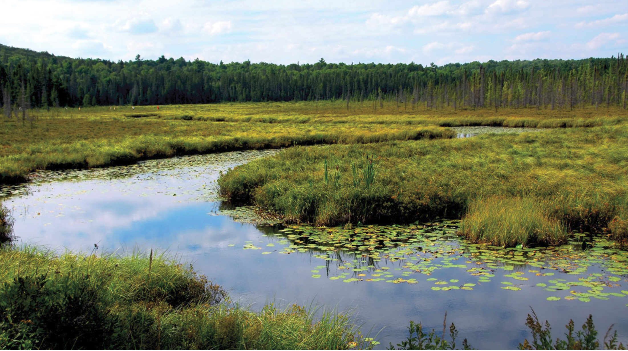
CVCA regulations Program OBJECTIVES
Protect the public from loss of life
Protect the public from loss of property
Regulate development with conditions so that hazards are not increased or created by development
Protect natural features and their ecological and hydrological goods and services (e.g. wetlands)
Notes:
The Conservation Authorities Act sets out CVCA responsibilities clearly. We are to: (CLICK)
Protect the public from loss of life (CLICK)
Protect the public from loss of property
Regulate development with conditions so that hazards are not increased or created by development
Protect natural features and their ecological and hydrological goods and services . For example, multiple studies have shown that wetland provide significant flood (e.g. flooding)
The most significant social and economic benefit that wetlands provide is flood control. Wetlands act like giant sponges, absorbing rainfall and controlling it’s flow into streams and rivers. When wetlands are removed or fragmented risk of flash floods is increased. Source: WWF

Slide 6
CVCA PERMIT Process
CVCA objectives are achieved by requiring a permit for development
A permit is issued if purposed works align with the Conservation Authorities Act and the Watershed Planning and Regulations Manual
If the project does not meet policy requirements, it is recommended for denial
Applicant is offered a right to appeal to the CVCA Board and ask for an exception
Notes:
These objectives are achieved by requiring a permit for development adjacent to natural hazards and natural features. (CLICK)
As Regulations Officers works with an applicant, permits are issued if the purposed works align with The Conservation Authorities Act, Regulation 159/05 and the Watershed Planning and Regulations Manual. (CLICK)
If issues are identified, negotiation often occurs during the permit application process so that the applicant is provided every opportunity to meet our policy requirements. Our end goal is to work with the landowner so that they can develop their property as they wish while assuring that they are protected from loss of life or property due to natural hazards.
Officers can only issue permits for development if the purposed works align with the CVCA Board Approved Policy Manual. It’s important to note that we do not have the Authority to issues permits that do not satisfy our policy requirements.
If the landowner wishes to more forward with development that does not meet our policy requirements, an Officer will recommend that the permit be denied. At this time, the landowner advised of their right to appeal this decision to the CVCA Board and ask for an exception.

Slide 7
Parties involved in a hearing
Hearing Board
Applicant, Agent,
or Invited Advisor
Regulations Officer
Decision
Notes:
At this point we’ve discussed that an applicant can request a hearing when a CVCA officer has recommend that their permit application be denied.
This opportunity allows them to come before you, the Hearing Board, and ask for an exception to the policies.
If the Hearing Board decides that the project does not meet CVCA objectives, they can uphold the Officers decision and deny the permit application as it stands. Or, if the Hearing Board allows the project to go forward, the applicant will receive a CVCA permit for development.
If the Board decides that the project can go forward, the CVCA then assumes legal liability if a natural hazard emergency occurs. For a simple example, lets say the CVCA has a Hearing with an individual who wants to triple the size of their dwelling within an identified flood plain. The applicant makes a strong case and the CVCA Hearing Board decides in the applicants favour. This means that if, in the future, a flooding emergency occurs this location that causes loss of life or property damage, the CVCA may be held legally responsible for allowing development to occur within a hazard.

Slide 8
Prehearing procedures
Hearing Information
Applicant is advised of hearing procedures
Notice of Hearing
Sufficient time and agreeable time and date
Electronic Hearings: The time, purpose of the hearing, and details about the manner in which the hearing will be held.
Pre-submission of Reports
2 weeks minimum to prepare report for submission
No Bias
Notes:
Now that we’ve discussed Hearing Board duties, lets move on to the Hearing procedures and Guidelines.
These guidelines are recommended by the MNRF, Conservation Ontario and are CVCA Board approved.
First, (CLICK) CVCA staff advise the applicant of our hearing processes and timelines. The average time that it takes to arrange a Hearing is 30 days or more. This so that staff and the applicant have time to prepare their case in time for the next CVCA scheduled Board Meeting. Board meeting dates are given to the applicant so that they can decide which meeting they are able to attend.
Once the applicant has confirmed (CLICK) which Board Meeting they wish to attend, a formal NOTICE OF HEARING will be mailed to them. For Electronic hearings please notethe Notice must also contain a statement that the applicant should notify the Authority if they believe holding the hearing electronically is likely to cause them significant prejudice. The Authority shall assume the applicant has no objection to the electronic hearing if no such notification is received.
Next, is the Pre-submission of reports. (CLICK) One week prior to the hearing, the applicant and CVCA staff will submit a report outlining their case. At this time the Board will be introduced to the case and can review the material provided by each party. Once this information is circulated in the Board Agenda Package, neither staff nor the applicant can submit new arguments or information regarding their case.
Last, it’s worth stressing that prior to and during the hearing, the hearing board is acting as a decision-making tribunal. It is critical that the members act fairly. Administrative law requires that not only must the hearing board avoid any bias towards to the case, the hearing board must also avoid even the appearance of bias.
This means that other than the Agenda package received prior to the Hearing, Board members participating in the deliberation and decision making must come to the meeting without any prior knowledge. If this cannot be achieved, the Board member must identify this apprehension of bias and remove themselves from the decision making process.

Slide 9
Conduct of hearing (1/2)
Hearings should be publically accessible where possible.
Electronic hearings should allow the public to join synchronously.
Record of attending Board Members
The Chair must ensure connectivity of all required attendees.
Opening Remarks
Presentation of Authority staff information
The Chair must ensure that all have/can follow the presentation.
Presentation of Applicant information
The Chair must ensure that all have/can follow the presentation.
Notes:
This slide is basically the Agenda of a Hearing, as well as addressing the new approved hearing protocols that have been put into place due to the Pandemic.
(CLICK AND READ)
Hearings should be publically accessible where possible.
Electronic hearings should allow the public to join synchronously.
Record of attending…
The Chair must ensure connectivity of all members as well as ensure that the hearing applicant can hears everyone and ensure that all members can heard the applicant.
Opening remarks
Presentation of Authority Staff information
Presentation of Applicant information

Slide 10
Conduct of hearing 2/2
Questions
Deliberation (may be in camera)
The moderator can control present parties
Decision (may be at a later date if necessary)
Adoption
Record
Notes:
(CONTINUE CLICK AND READ)
Questions
Prior to questions be formally started the Chair should ensure that all parties and members can still connected and able to field questions/hear responses.
Deliberation
Traditionally we have had applicants remove themselves from the board room after the presentations and questions so deliberation could occur. The moderator for the electronic board meeting/hearing could remove the applicant after the Chair informs them that they will now deliberate and they will be informed of the Boards decision within the allotted timeframe,
Decision
Adoption
RECORD IS LAST POINT

Slide 11
Appealing to the Mining and Lands Tribunal
Mining and Lands Tribunal
Applicant, Agent,
or Invited Advisor
CVCA
Decision
Notes:
ONCE the Hearing Board makes a decision, it is not necessarily the end of the road for the applicant if they remain unsatisfied with the decision.
If they’d like, the applicant can appeal the CVCA’s decision to the Minister bring their case before the Mining and Lands Tribunal. The M+L Tribunal has rendered decisions on exactly this issue before so while this process may be new for us, it is well established.

Slide 12
Why are we Talking About hearing guidelines?
There are potentially several hearings to be occurring in the near future.
Notes:
I’ll end this presentation with where I began.
Board members are encouraged to download the CVCA policy manual and review Append D – Hearing Guidelines. prior to any CVCA Board Meetings.

Slide 13
Check Out the CVCA Website
Notes:
You can do this by heading over to our website.

